Slide 1
Data analysis in Stata
EARNcon Cleveland 2022
September 28, 2022
Zane Mokhiber

Slide 2
Overview
Analyze published state level data from BLS in Stata
Supplement published data with CPS microdata analysis
Output basic analysis of unemployment rates and median wages by Race/Ethnicity in Ohio

Slide 3
Learning Objectives/Key Ideas
Using BLS data in a “Tidy” manner (Tidy data)
Supplementing published statistics with CPS microdata to allow for more fine grain analysis
Dealing with small sample sizes and data volatility over time
Shameless EPI self promotion

Slide 4
Before we get started:
Install EPI written Stata commands
net install load_epiextracts, from("https://microdata.epi.org/stata")
net install binipolate, from("https://raw.githubusercontent.com/Economic/binipolate/master/")

Slide 5
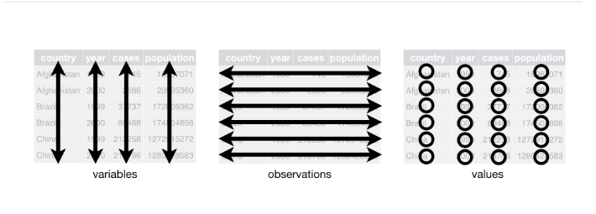
What is Tidy Data?
see https://r4ds.had.co.nz/tidy-data.html, and https://vita.had.co.nz/papers/tidy-data.html

Slide 6
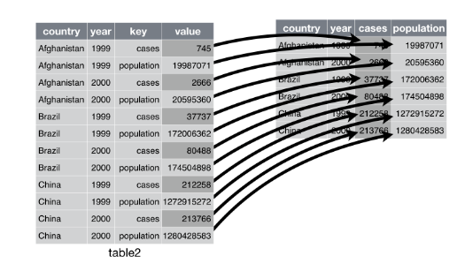
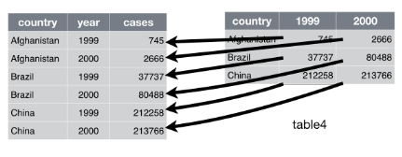
Tidy examples

Slide 7
Making BLS data Tidy
BLS series ID finder
Output is not that tidy
Series IDs used:LASST390000000000003, LASST420000000000003
Reshape in Stata, or…
Access tidy(ish) data from download.bls.gov and parse it

Slide 8
Supplementing with CPS Microdata
EPI harmonized CPS microdata files https://microdata.epi.org/
Check out the “how to use” section
LAUS data only publishes overall unemployment rates, not by race/ethnicity
CPS can be tough to work with at state level
Volatility due to small sample sizes by race
Seasonality

Slide 9
Avenues for addressing sample size issues
Pooling data over multiple months/years
Good for snapshot of a single time period
Moving averages
Allows for insight into changes over time
Ex: https://www.epi.org/data/#?subject=unemp
Combining LAUS and CPS microdata
Ex: https://www.epi.org/indicators/state-unemployment-race-ethnicity/

Slide 10
Examining wages in CPS
Percentiles give you a good overview of wage distrubtions
Clumping around specific percentiles can cause problems
Use EPI’s Binipolate to resolve
Published EPI resources
https://www.epi.org/data/#?subject=wage-avg
https://swx.epi.org/

Slide 11
Getting usable output
Tidy data is great for Stata, not so great to glean insights from
Use collapse and reshape to get your data into human readable, simple tables
Export to excel/csv

Slide 12
Thanks for joining!
Additional resources
Princeton intro to stata: https://data.princeton.edu/stata
UCLA learning modules https://stats.idre.ucla.edu/other/mult-pkg/seminars/#Stata and here https://stats.idre.ucla.edu/stata/modules/
Stata video tutorials https://www.stata.com/links/video-tutorials/ https://www.stata.com/training/webinar/
Stata cheat sheets: https://www.stata.com/bookstore/statacheatsheets.pdf
My contact info: email: zmokhiber@epi.org I twitter: @zanemokhiber

